Slide 1
Identification of Disease-Treatment Relations In Bio-Science Text Final Year Project
Final Review
Kartheek Anumolu
10mse1027

Slide 2
Problem Statement
People are very much cautious of their health and want to be well informed about the recent advancements in medical domain. There is an enormous increase in number of people searching disease related information over web. Health related information are very sensitive to trust and standardizing the data would increase the truthfulness of the results.
There is a need to develop an interface that can assist people and medical people with Disease Treatment relations

Slide 3
Objective
The main objective of this project is to process the Disease-Treatment relations from the Medline data and prepare a database and then provide the people with an interface to know a treatment to a particular disease.

Slide 4
How do we get the treatment information and how to trust it ??

Slide 5
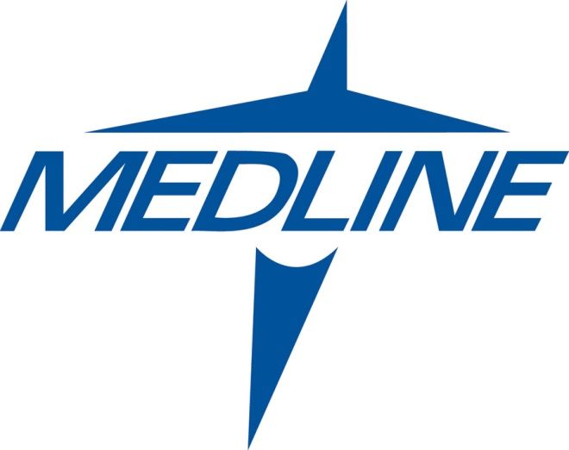

Slide 6
MEDLINE ??
It is a bibliographic database of life sciences and biomedical information. It includes information from academic journals covering medicine, nursing, pharmacy, dentistry, veterinary medicine, and health care.
Compiled by the United States National Library of Medicine (NLM)

Slide 7
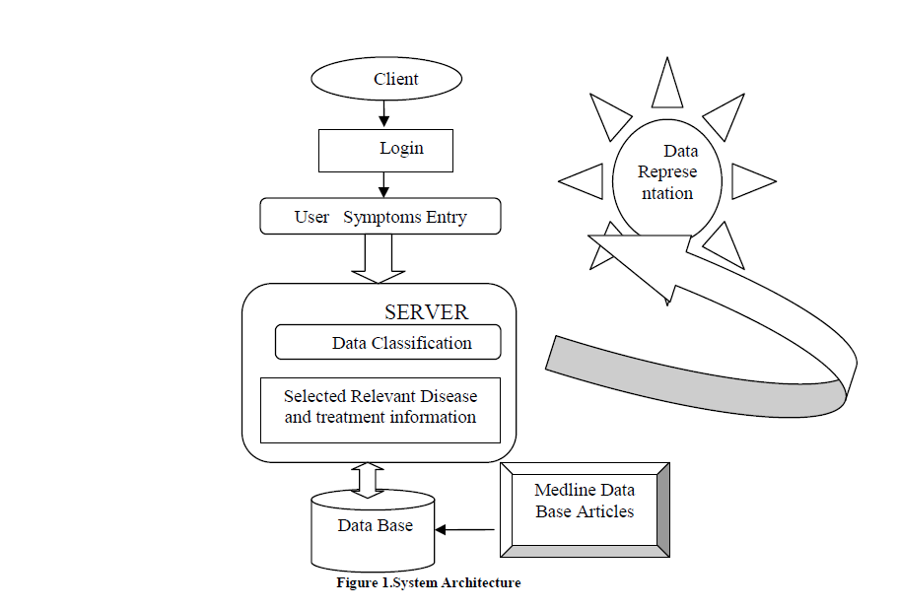
Proposed System Architecture

Slide 8
Module Description
Module 1:
Taking the medical abstracts and finding the diseases and tagging the found diseases and similarly for treatments
Module 2:
In this module we do line taggers to identify the disease treatment relations and extract to database
Module 3:
Providing an interface to the people to find a treatment for a disease.

Slide 9
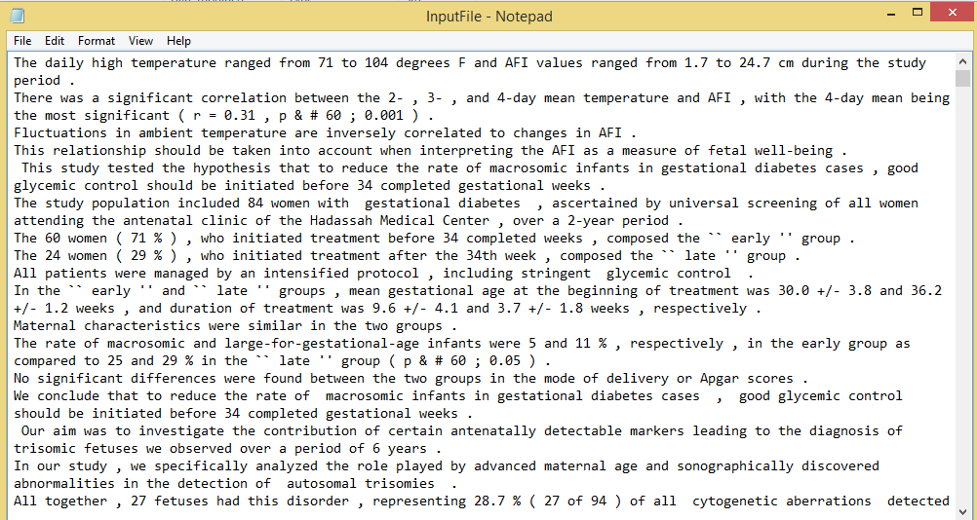
Module 1

Slide 10
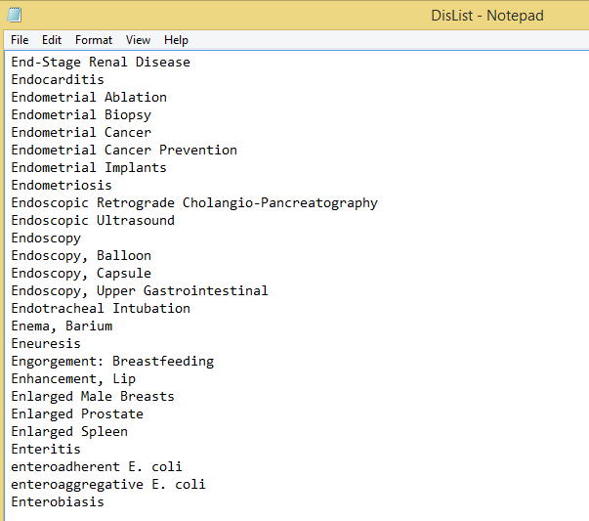
Module 1

Slide 11
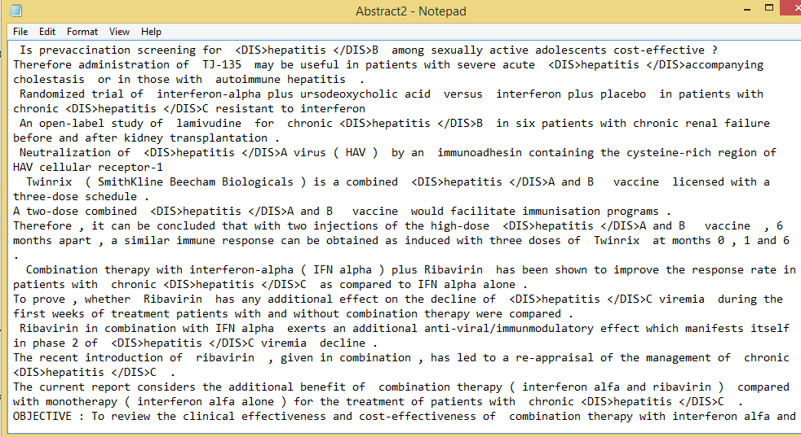
Module 1

Slide 12
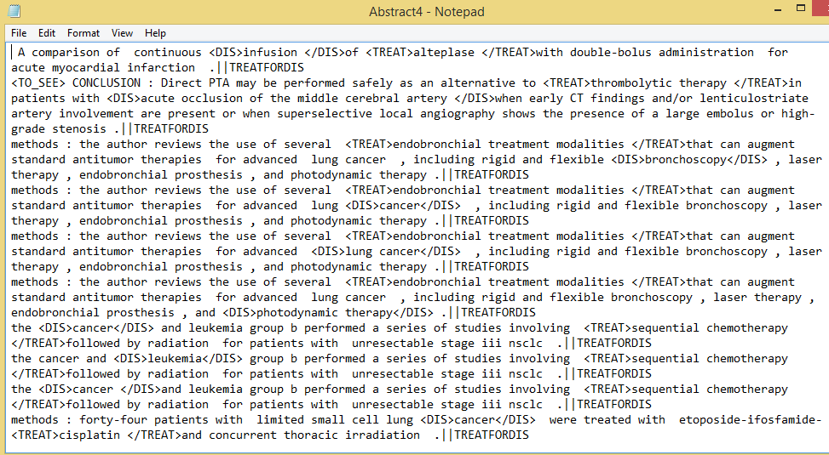
Module 2

Slide 13
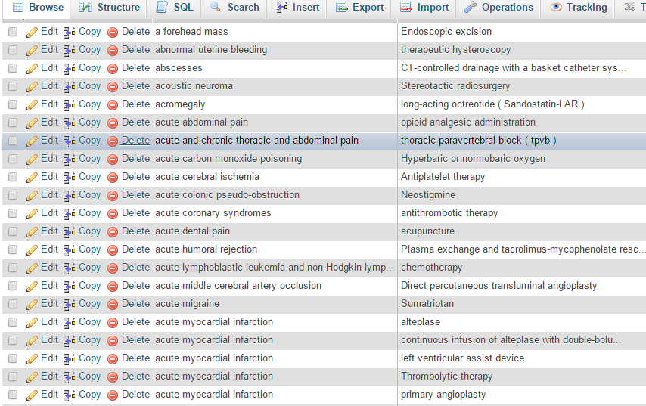
Module 2

Slide 14
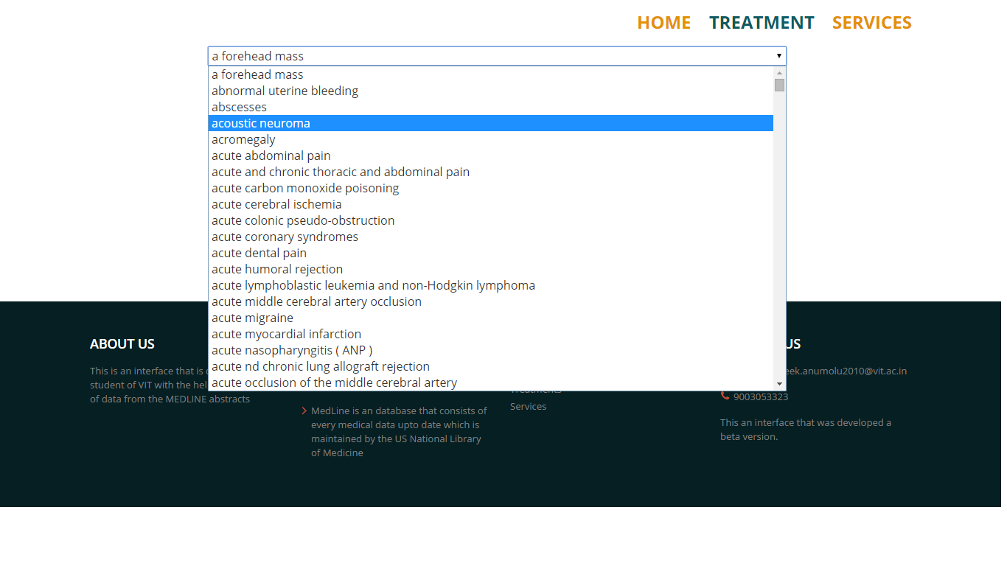
Module 3

Slide 15
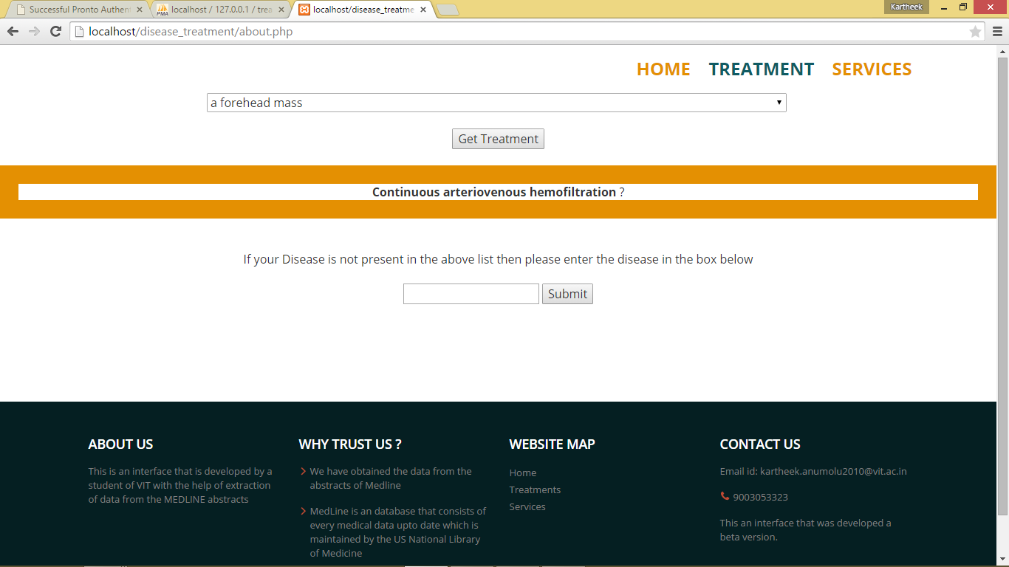
Module 3

Slide 16
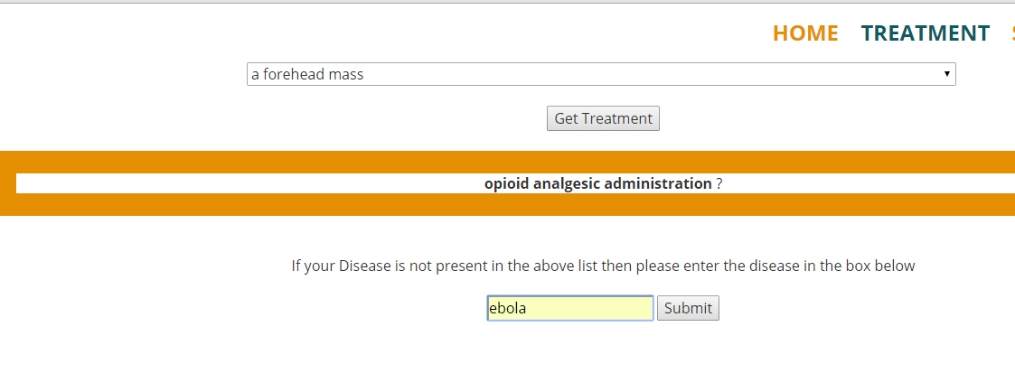
Module 3

Slide 17
Future Work
Providing information about the treatment to the users with no medical knowledge
Taking input of the disease not present in the drop down list and storing it and then later comparing the disease with data preprocessing process.
Try to provide the users with preventive measures and also tell side effects if present any

Slide 18
References
Oana Frunza, Diana Inkpen, and Thomas Tran " A Machine Learning Approach for Identifying Disease-Treatment Relations in Short Texts" vol. 23, 2011.
B. Rosario and M.A. Hearst, “Semantic Relations in Bioscience Text,” Proc. 42nd Ann. Meeting on Assoc. for Computational Linguistics, vol. 430, 2004.
Qin, Z., 2006, Naive bayes classification given probability estimation trees.
Learning to Extract Relations from Medline , Mark Craven, Carnegie Mellon University
NLM US National Library of Medicine

